Slide 1
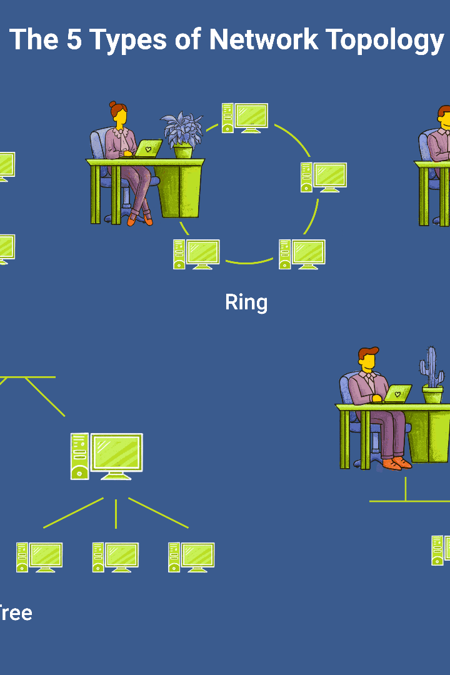

Defination :
A network topology is the physical and logical arrangement of nodes and
connections in a network. Nodes usually include devices such as switches, routers and
software with switch and router features. Network topologies are often represented as a
Graph .
Types of Network Topology
Point to Point Topology
Mesh Topology
Star Topology
Bus Topology
Ring Topology
Tree Topology
Hybrid Topology
Network Topology
Rajibul Molla

Slide 2
Name | Advantages | Disadvantages
Mesh Topology | Communication is very fast between the nodes. Mesh Topology is robust . The fault is diagnosed easily. Data is reliable because data is transferred among the devices through dedicated channels or links. Provides security and privacy | Installation and configuration are difficult. The cost of cables is high as bulk wiring is required, hence suitable for less number of devices. The cost of maintenance is high
Star Topology | If N devices are connected to each other in a star topology, then the number of cables required to connect them is N. So, it is easy to set up. Each device requires only 1 port i.e. to connect to the hub, therefore the total number of ports required is N. It is Robust. If one link fails only that link will affect and not other than that. Easy to fault identification and fault isolation. Star topology is cost-effective as it uses inexpensive coaxial cable. | Performance is based on the single concentrator i.e. hub . If the concentrator (hub) on which the whole topology relies fails, the whole system will crash down. The cost of installation is high.
Bus Topology | If N devices are connected to each other in a bus topology, then the number of cables required to connect them is 1, known as backbone cable, and N drop lines are required . Coaxial or twisted pair cables are mainly used in bus-based networks that support up to 10 Mbps. The cost of the cable is less compared to other topologies, but it is used to build small networks. | A bus topology is quite simpler, but still, it requires a lot of cabling. If the common cable fails, then the whole system will crash down. If the network traffic is heavy, it increases collisions in the network. To avoid this, various protocols are used in the MAC layer known as Pure Aloha, Slotted Aloha, CSMA/CD, etc. Adding new devices to the network would slow down networks. Security is very low.
Ring Topology | The data transmission is high-speed. The possibility of collision is minimum in this type of topology. Cheap to install and expand. It is less costly than a star topology. | The failure of a single node in the network can cause the entire network to fail. Troubleshooting is difficult in this topology. The addition of stations in between or the removal of stations can disturb the whole topology. Less secure

Slide 3
Name | Advantages | Disadvantages
Tree Topology | It allows more devices to be attached to a single central hub thus it decreases the distance that is traveled by the signal to come to the devices. It allows the network to get isolated and also prioritize from different computers. We can add new devices to the existing network. Error detection and error correction are very easy in a tree topology. | If the central hub gets fails the entire system fails. The cost is high because of the cabling. If new devices are added, it becomes difficult to reconfigure.
Hybrid Topology | This topology is very flexible. The size of the network can be easily expanded by adding new devices. | It is challenging to design the architecture of the Hybrid Network. Hubs used in this topology are very expensive. The infrastructure cost is very high as a hybrid network requires a lot of cabling and network devices.

Slide 4
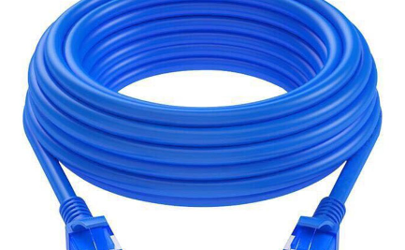
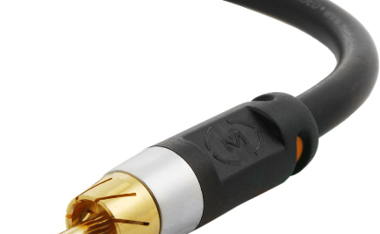
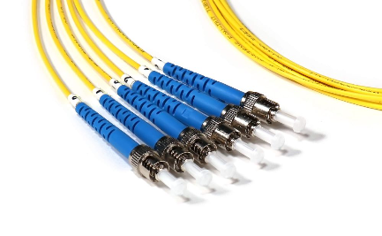
Cabling: The Backbone of Networks
Ethernet Cable
Coaxial Cable
Fiber Optic Cable
Learn about the various types of Ethernet cables, including Cat 5e, Cat 6, and fiber optic cables, and their applications in network connectivity.
Discover the features and benefits of coaxial cables, commonly used in television and internet connections, and how they transmit data signals.
Explore the advantages of fiber optic cables, which use light signals for high-speed data transmission, and their role in long-distance networking.

Slide 5
The Building Blocks: Devices in a Network
Router
Switch
Learn how routers connect multiple networks and enable devices to communicate with each other, effectively acting as the traffic coordinators of the internet.
Discover how switches facilitate communication within a local network by filtering and forwarding data packets between devices.
Firewall
Access Point
Explore the role of firewalls in network security, protecting against unauthorized access and monitoring incoming and outgoing network traffic.
Understand how access points provide wireless network connectivity, allowing devices to connect to a wired network without the need for cables.

Slide 6

Unraveling the DNS Protocol
1
Domain Name System
Explore the purpose and function of the Domain Name System (DNS), which translates domain names into IP addresses for efficient network communication.
2
DNS Query Process
Understand how DNS queries work, including the recursive and iterative query process to find the IP address associated with a domain name.
3
DNS Caching
Discover the benefits of DNS caching, a mechanism that stores previously resolved DNS queries to improve efficiency and reduce network latency.

Slide 7
Unlocking the Power of Virtual LANs (VLANs)
1
Segmenting Networks
2
Flexible Network Design
3
Reduced Network Traffic
Learn how VLANs divide a single physical network into multiple logical networks, enhancing security, scalability, and network management.
Discover how VLANs enable flexible network design by allowing different departments or groups to communicate securely and efficiently.
Explore how VLANs optimize network performance by reducing broadcast traffic, isolating network issues, and improving overall efficiency.

Slide 8

Conclusion
By understanding network topology, cable types, devices, the DNS protocol, and virtual LANs, you can build robust and efficient networks to meet your organization's needs.

